Slide 1
Sales Predictions
From Data Cleaning to Machine Learning

Slide 2
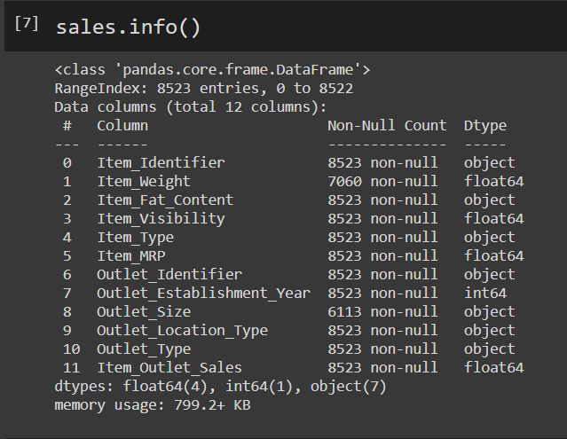
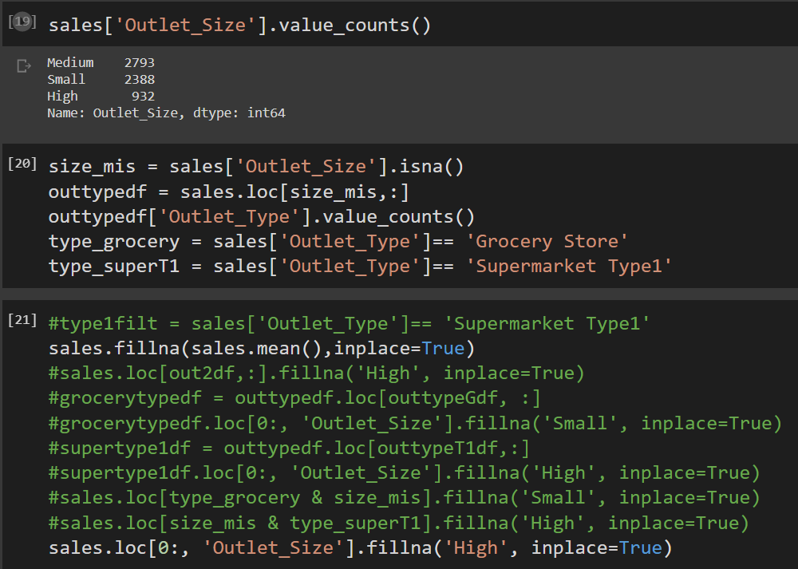
Data Cleaning
Dataframe info
Addressing missing information
Reasoning

Slide 3
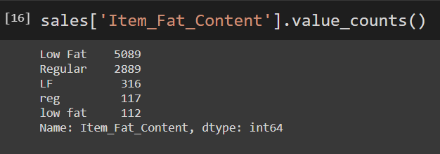
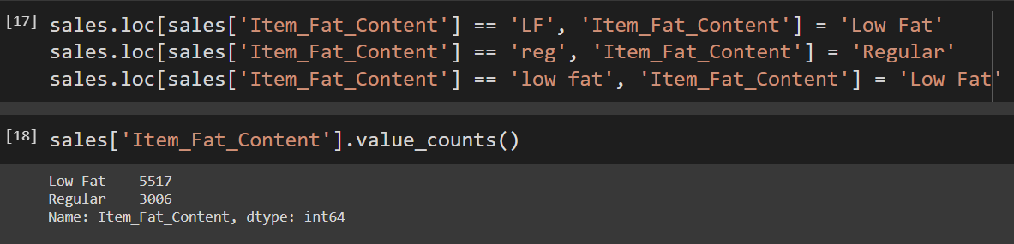
Data Cleaning Continued…
Different values meaning the samething
Fixed issues

Slide 4
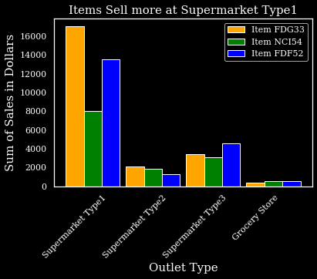
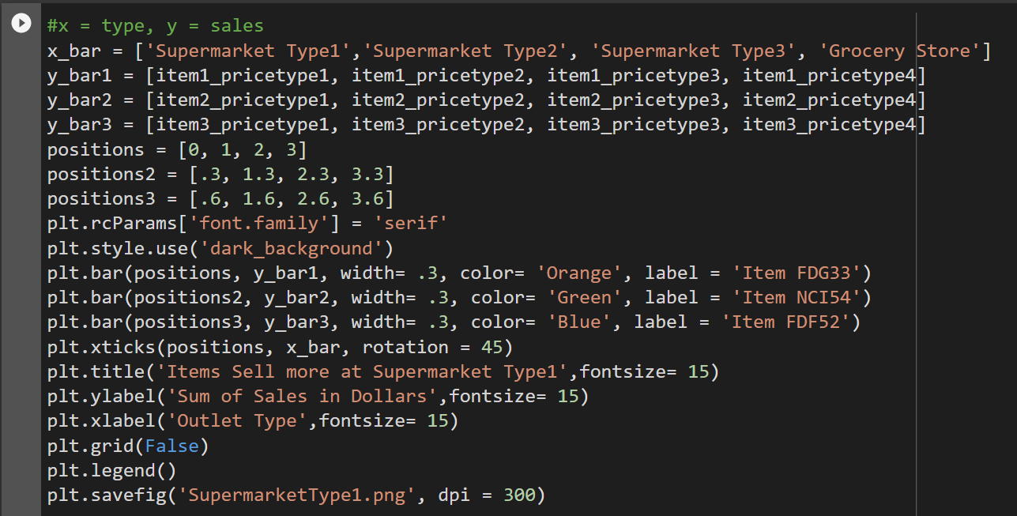
Data Visualizations
Total Outlet Sales
Different Items

Slide 5
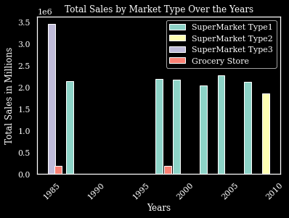
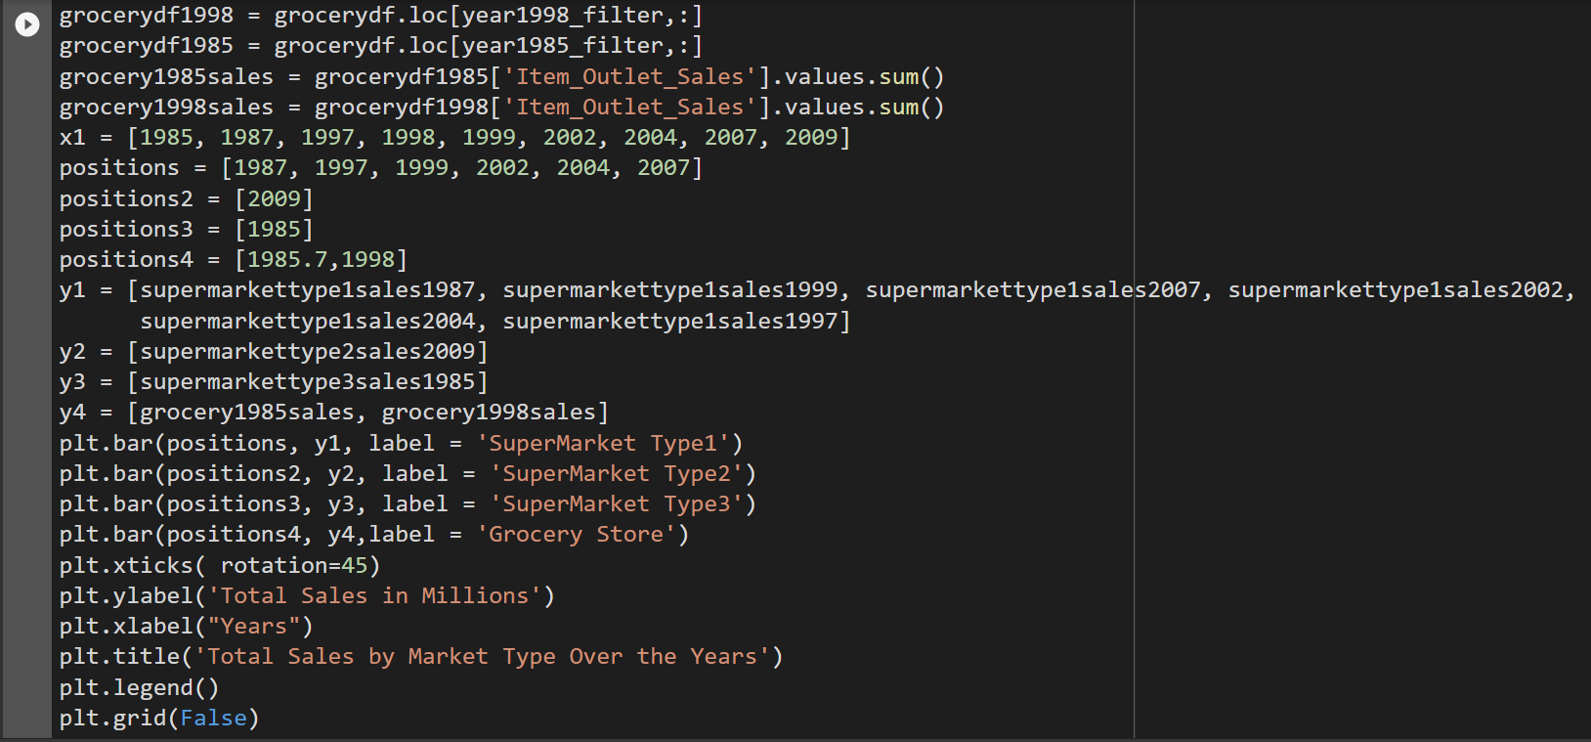
Data Visualizations Continued…
Market type and Totals Sales

Slide 6
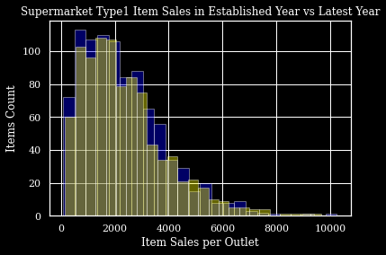
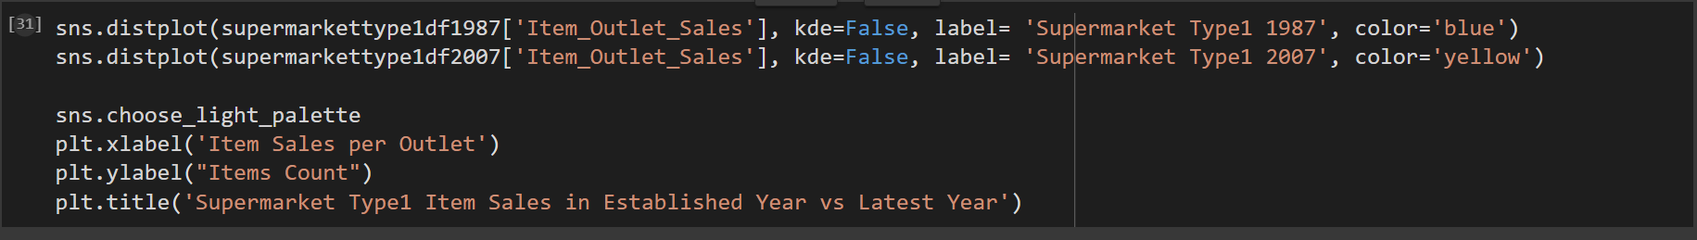
Data Visualizations Continued…
Item sales per Outlet

Slide 7
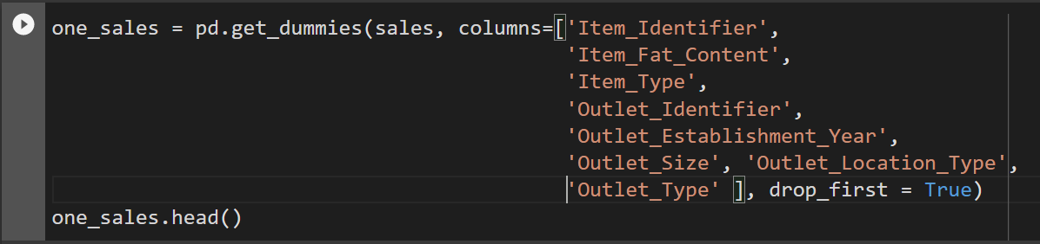
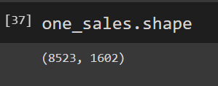
Machine Learning Model
Data Preparation
Confirming new Dataframe

Slide 8
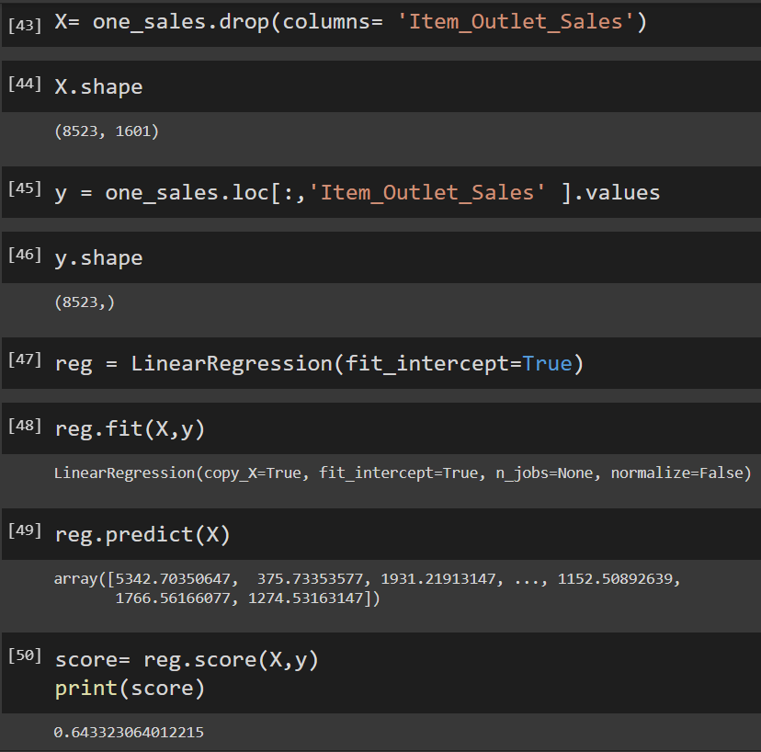
Machine Learning Model Continued…
Linear Regression Model

Slide 9
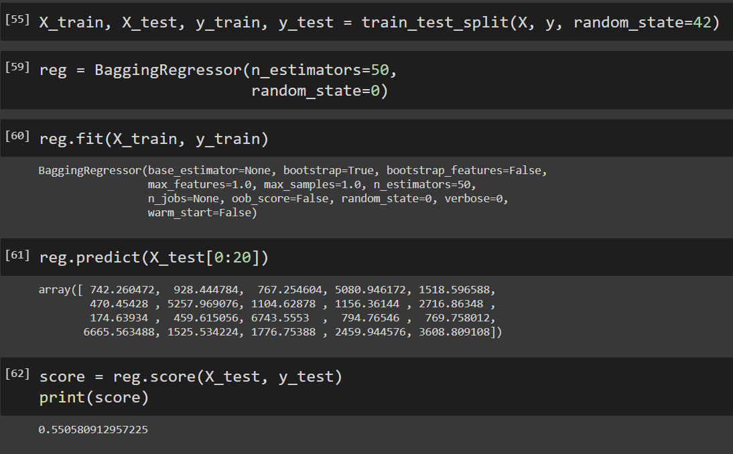
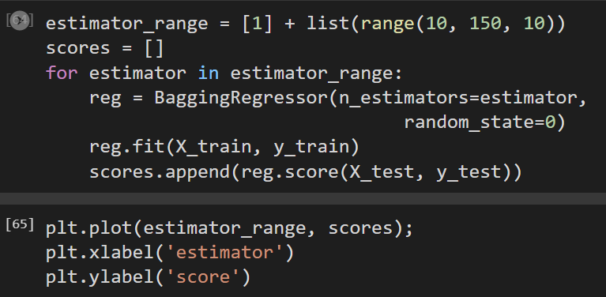
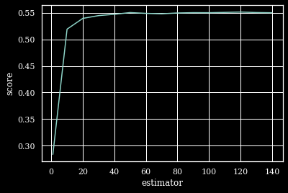
Machine Learning Model Continued…

